Slide 1

HR Analytics Dashboard: Power BI Project With python
This Power BI project provides insightful visualizations and analysis of HR data, empowering HR professionals to make data-driven decisions and improve employee engagement.

Slide 2

About the Project
The HR Analytics Dashboard offers a comprehensive overview of key HR metrics and trends.
1
Employee Count
2
Attrition Trends
Provides a snapshot of the total number of employees.
Shows the number and rate of employees leaving the company.
3
Demographics
4
Job Satisfaction
Provides insights into employee age, gender, and education.
Reveals employee satisfaction levels across different roles.

Slide 3
Overview of the project
This project involves the development and analysis of an Employee Attrition Dashboard using Power BI to understand factors driving employee turnover and provide actionable insights for improvement. The dashboard highlights key metrics such as employee demographics, job satisfaction, performance ratings, income distribution, and attrition rates across various departments, roles, and demographics.
Technologies Used
The project utilizes Power BI and Excel to create interactive and insightful visualizations.
Power BI
Excel
A powerful business intelligence tool for data visualization and analysis.
A spreadsheet software used for data manipulation and preparation.
Python
Data prediction

Slide 4
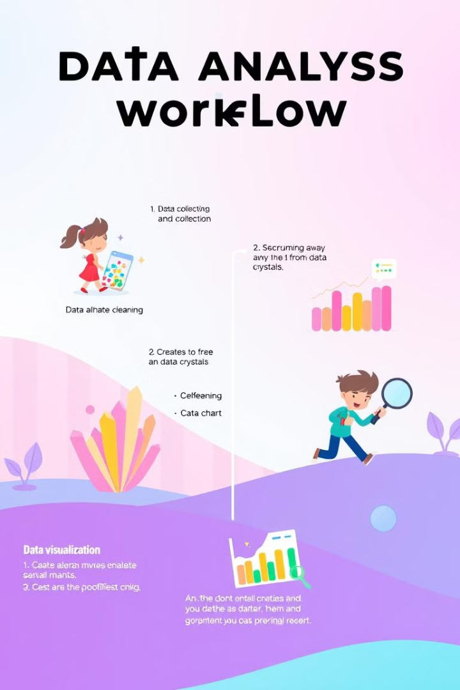
Steps Overview
The project follows a structured approach to data analysis and visualization.
1
Data Collection
Gathering HR data from various sources.
2
Data Cleaning
Identifying and addressing data inconsistencies and errors.
3
Data Visualization
Creating interactive charts and graphs to represent data insights.

Slide 5
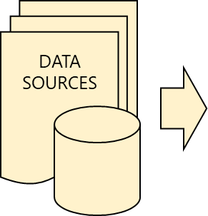

HR Dataset Overview
Summary of HR and Engagement Survey Data
The HRIS sheet contains 26 columns focusing on employee demographics, roles, and job-related metrics.
Key Information:
- Employee Demographics: Name, Office, Age, Gender, Marital Status
- Job Metrics: Attrition, Business Travel, Department, Job Role, Job Level, Monthly Income, Years At Company, maps coordinate X&Y
Engagement Survey Sheet Overview
The Engagement Survey sheet measures employee satisfaction and engagement.
Key Information:
- Satisfaction Metrics: Relationship Satisfaction, Job Satisfaction, Environment Satisfaction
- Work Metrics: Training Times Last Year, Work Life Balance, Job Involvement

Slide 6
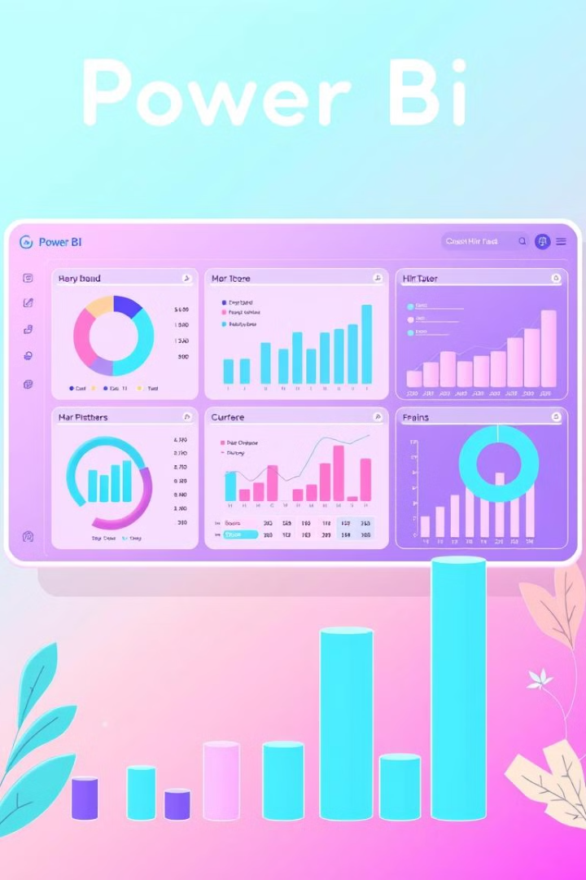

Dashboard Content
This dashboard provides insights into employee metrics for a pharmaceutical company:
KPI Sheet
Department-wise Attrition
Displays key performance indicators like employee count, attrition rate, and average age.
Shows the distribution of attrition across different departments.
key influencers
The Key Influencers visualization in Microsoft Power BI is a machine learning tool that helps users identify the factors that most impact a metric or condition in their data

Slide 7
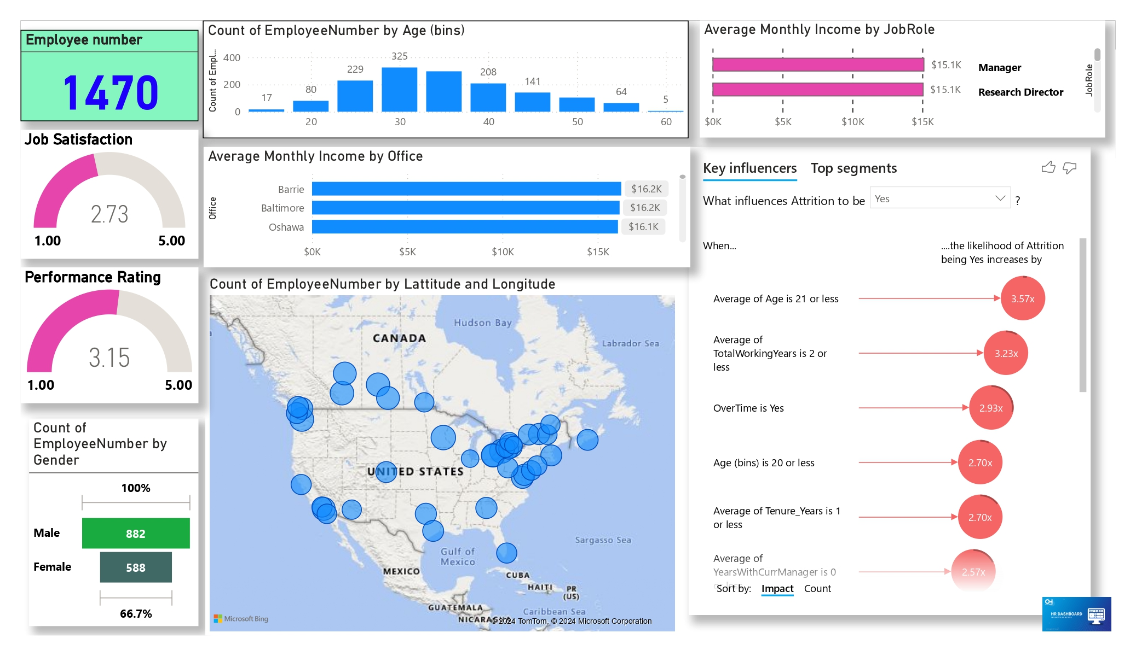

Slide 8
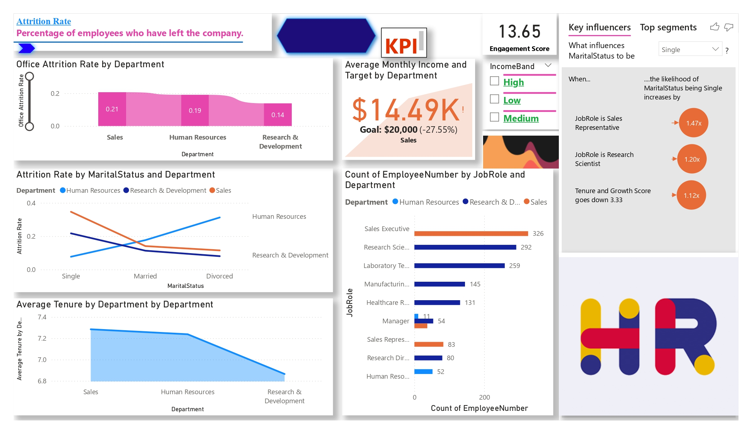

Slide 9

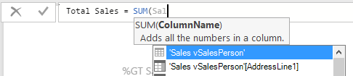
Data Analysis Expressions
DAX is a collection of functions, operators, and constants that can be used in a formula, or expression, to calculate and return one or more values.
Data Analysis Expressions, or “DAX” includes a library of over 200 functions, operators, and constructs and are similar to Excel formulas
Office Attrition Rate =
DIVIDE(
COUNTROWS(FILTER(HRIS, HRIS[Attrition] = "Yes")),
COUNTROWS(HRIS),
0
)
Tenure and Growth Score =
AVERAGEX(
HRIS,
DIVIDE(
[TotalWorkingYears] + [YearsWithCurrManager] +
[YearsSinceLastPromotion] + [YearsInCurrentRole] +
[Tenure_Years] + [PercentSalaryHike],
6
)
)
Notes:
Data Analysis Expressions, or “DAX” includes a library of over 200 functions, operators, and constructs and are similar to Excel formulas. DAX has many of the same functions as Excel, except that DAX functions are meant to work over data interactively “sliced” or filtered in a report. If users are familiar with writing Excel functions, its an easy transition into DAX.

Slide 10
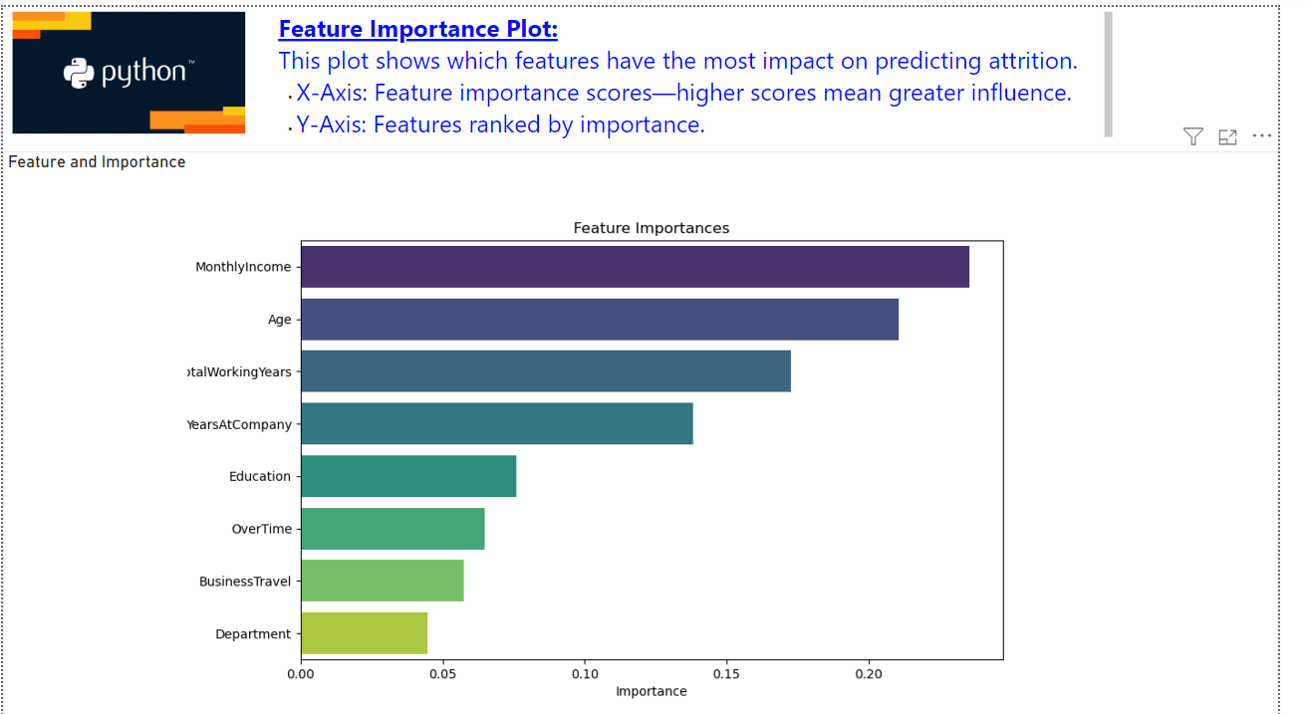

Key Factors Influencing Attrition:
Salary: Higher monthly income is associated with lower attrition rates.
Experience: Longer tenure and more years of experience correlate with lower attrition.
Overtime: Employees working overtime are more likely to leave.
Age: Older employees tend to stay longer.
Less Significant Factors:
Education: Moderate impact on attrition.
Business Travel: Minimal impact on attrition.
Department: Least significant factor.
Note
Predictions made by the
Random Forest Classifier.

Slide 11

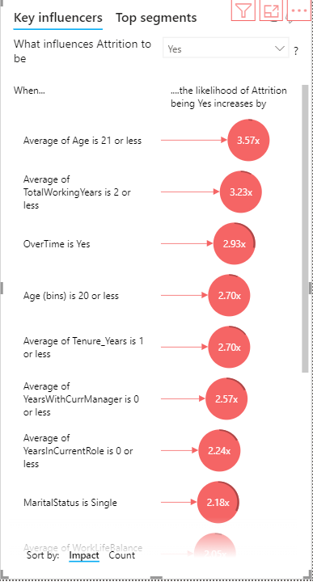
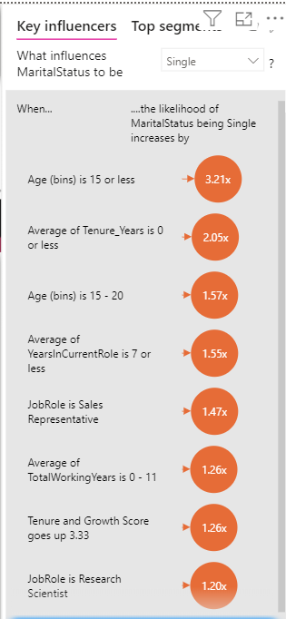

Slide 12
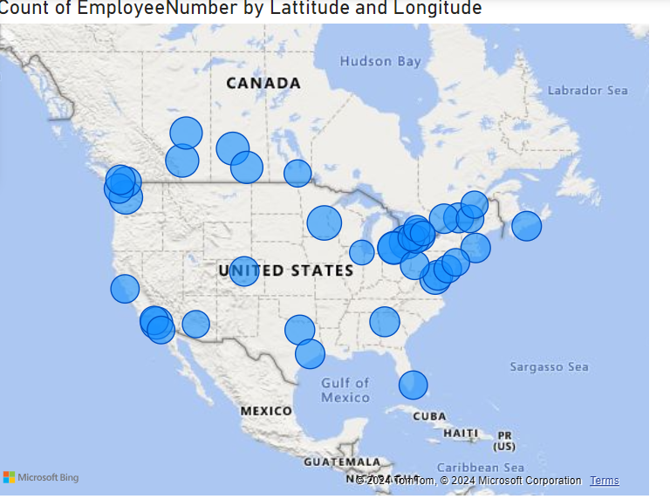
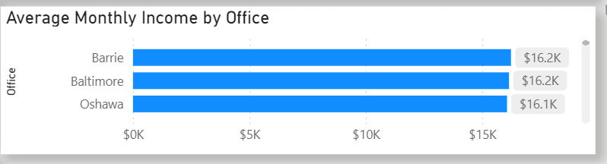

The map is representing that all our employees are from USA and Canada
Highest monthly income is in Barrie and Baltimore office.

Slide 13
This dashboard provides key workforce insights for a pharmaceutical company:
Overall Trends:
Attrition is highest in Sales (21%), moderate in HR (19%), and lowest in R&D (14%).
Key Drivers:
Young employees (≤21 years) and those with ≤2 years of tenure are most likely to leave.
Overtime increases attrition likelihood significantly.
Single employees show the highest attrition rates.
Role and Income Factors:
Roles like Sales Representatives and Research Scientists face higher attrition risks.
Sales department income is 27.55% below target, likely contributing to dissatisfaction.
Engagement and Satisfaction:
Moderate scores for engagement (13.65) and job satisfaction (2.73) suggest room for improvement.
Work-life balance and career growth are key areas to address.

Slide 14
SUGGESTIONS FOR IMPROVEMENT
Job Satisfaction:
Conduct employee engagement surveys.
Offer wellness programs and recognize employee contributions.
Performance Ratings:
Provide training and regular feedback to improve performance.
Gender Diversity:
Promote equal opportunities and flexible working conditions
Reduce High Attrition in Sales:
Improve incentives and reduce workload stress.
Offer training and career growth opportunities.
Retain Younger and Less-Tenured Employees:
Implement mentorship programs.
Provide clear career progression paths.
Address Work-Life Balance:
Minimize overtime workloads.
Offer flexible work arrangements.
Support Single Employees:
Provide social engagement activities and work-life balance perks.
Tackle Income Gaps:
Align salaries with industry benchmarks.
Introduce bonuses or rewards for target achievements.
Enhance Engagement and Satisfaction:
Strengthen onboarding programs and recognize employee contributions.
Conduct regular surveys to address dissatisfaction proactively.

Slide 15
CONCLUSION FOR HR ANALYSIS
Monthly Income, Age, and Total Working Years are key drivers of employee attrition.
Highest attrition rates in certain departments due to low monthly income and job dissatisfaction.
Single employees are at higher risk of leaving than married or divorced employees, especially in demanding roles.
Frequent overtime increases likelihood of leaving by 2.93x.
Geographical Analysis identifies employee clusters for localized engagement and retention strategies.
Employees with lower job satisfaction and shorter tenure are more likely to leave.
Recommendations include revising compensation packages, reducing overtime, enhancing work-life balance, and tailoring retention strategies.

Slide 16
THANK YOU!!

Slide 17
Test slide//
slide 11 The Key Influencers chart shows factors increasing the likelihood of employees being single:
Age: Younger employees (≤15 years) are 3.21x more likely to be single, and those aged 15–20 are 1.57x more likely.
Tenure: Newer employees (tenure ≤ 0 years) are 2.05x more likely to be single.
Job Role: Sales Representatives (1.47x) and Research Scientists (1.20x) are more likely to be single.
Experience: Employees with ≤11 total working years are 1.26x more likely to be single.
Growth Focus: Higher Tenure and Growth Scores (3.33) correlate with a 1.26x increase in being single.Younger, early-career employees are more likely to be single, reflecting their career and life stage.

